Slide 1


Crime Analysis in India using Python
This presentation explores the analysis of crime data in India using Python, focusing on identifying patterns, trends, and actionable insights. The analysis leverages powerful Python libraries like Pandas, Seaborn, and Matplotlib for data manipulation, visualization, and statistical analysis.
by Rohit Sharma

Slide 2

Overview
The primary objective is to analyze crime data from India to understand crime trends, identify high-crime areas, and provide insights for policy formulation. The analysis utilizes a crime dataset from India, encompassing various crime types, locations, and reporting details.
1
Data Cleaning and Preprocessing
2
Exploratory Data Analysis (EDA)
The initial step involves cleaning and preprocessing the data, addressing missing values, removing duplicates, and converting date columns to the appropriate datetime format.
EDA is conducted to gain a comprehensive understanding of the data, including identifying key variables, exploring relationships, and summarizing patterns.
3
Visualizations for Insights
Visualizations are employed to effectively communicate findings and provide insights into crime trends, geographical distribution, and other relevant aspects.

Slide 3
Objective
The analysis aims to achieve the following objectives:
Understand Crime Trends
Identify High-Crime Areas
Provide Actionable Insights
Analyze crime data to identify patterns and trends over time, including seasonal variations and long-term changes.
Determine geographical locations with high crime rates, enabling targeted interventions and resource allocation.
Generate insights that can inform policy decisions, law enforcement strategies, and crime prevention initiatives.

Slide 4
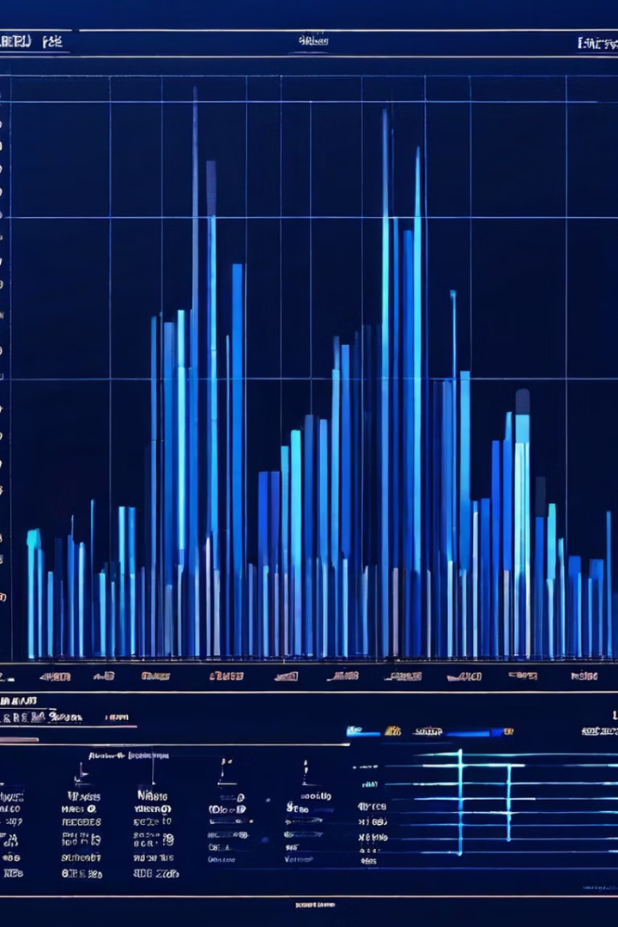
Data Structure
The crime dataset comprises X rows and Y columns, providing a comprehensive overview of crime incidents in India. Key columns include:
Crime Description
Type of crime committed.
City
Location of the crime incident.
Date Reported
Date when the crime was reported.
Victim Age
Age of the victim involved in the crime.
Data cleaning steps include handling missing values, removing duplicate entries, and converting date columns to the appropriate datetime format.

Slide 5

Descriptive Statistics
Descriptive statistics provide a summary of the data, including measures of central tendency (mean, median) and dispersion (standard deviation). These statistics offer insights into the overall characteristics of the crime data.
1
Victim Age Distribution
A boxplot visualizes the distribution of victim ages, highlighting the range, quartiles, and potential outliers.
2
Crime Trends by Month
A line graph depicts the monthly trends in crime reporting, revealing seasonal patterns and fluctuations.
3
Findings
The analysis reveals that most victims fall within a specific age range, and there are noticeable seasonal patterns in crime reporting.

Slide 6
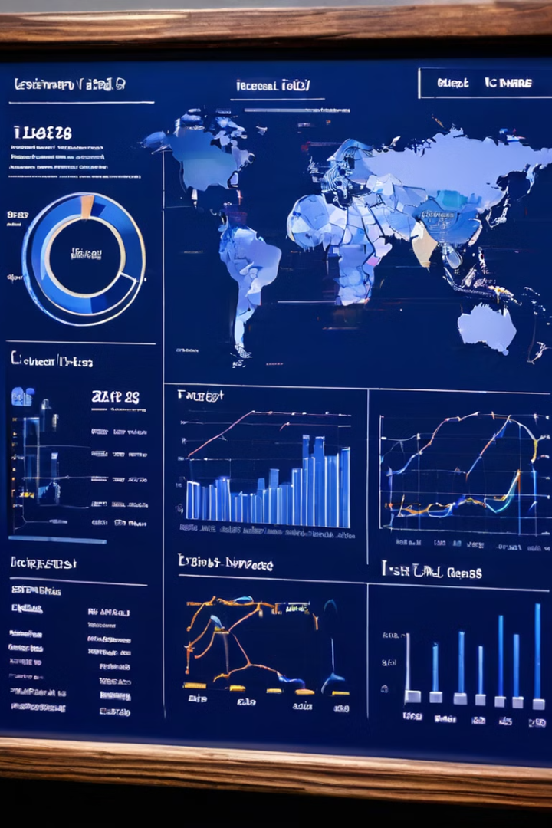
Key Insights
The analysis reveals several key insights into crime trends in India:
Top Crime Types
Monthly Trends
A bar plot illustrates the frequency of different crime descriptions, highlighting the most prevalent crime types.
A line plot indicates fluctuations in crime reporting across months, revealing peaks and troughs in crime activity.
City-wise Distribution
A bar plot displays the top 10 cities with the highest crime rates, identifying high-crime areas for targeted interventions.

Slide 7

Possible Areas for Further Study
The analysis provides a foundation for further exploration and investigation. Potential areas for future study include:
1
Correlation Analysis
2
Predictive Modeling
Investigate correlations between socio-economic factors and crime rates, exploring potential relationships and influencing factors.
Develop predictive models to forecast future crime trends based on historical data and identified patterns.
3
Crime Severity Analysis
Categorize crimes based on their severity and impact, enabling a more nuanced understanding of crime trends and consequences.

Slide 8

Conclusion
The analysis of crime data in India using Python provides valuable insights into crime trends, high-risk areas, and prevalent crime types. These insights can guide law enforcement and policymakers in allocating resources effectively and developing targeted interventions.
Future work could focus on integrating real-time crime data for ongoing analysis, enabling more dynamic and responsive crime prevention strategies.

